Slide 1


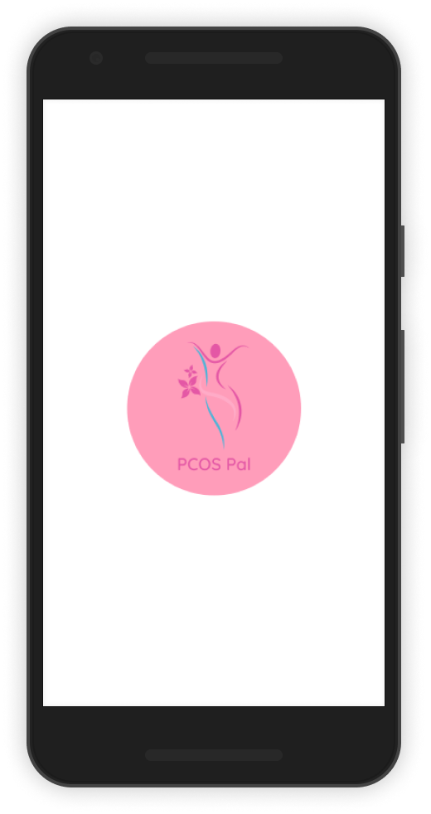


PCOS Pal
YOUR ULTIMATE COMPANION IN PREVENTING PCOS!
C23-PS058

Slide 2
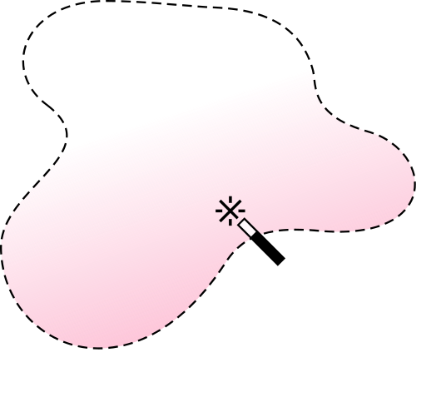







PCOS Pal
Great People Behind The Scenes
I Putu Crisna Putra
Ardhika
Farhan Yusuf
Muhammad Jalu Herlambang
Farhan Habib
Mordekhai Gerine Lumangkun
Benny Daniel
Bahari
Machine Learning
Machine Learning
Machine Learning
Cloud Computing
Cloud Computing
Mobile Development

Slide 3

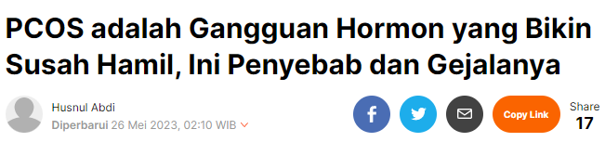

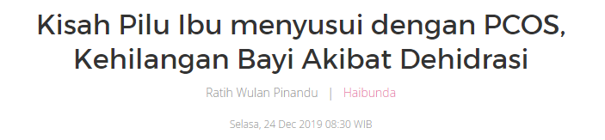
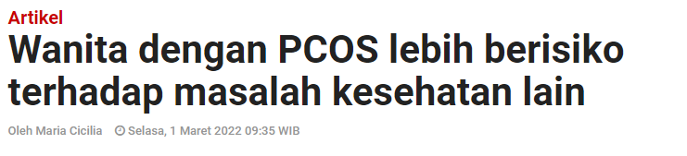
PCOS Pal
Problem Background
Polycystic ovary syndrome (PCOS) is an endocrine-gynecology disorder affecting many women of childbearing age. *
In fact, up to 15% of the female population worldwide has been affected by this syndrome. **
If not treated properly, it can be lead to serious health problems even can have fatal consequences leading to death. ***
Unfortunately, for women, particularly in Indonesia, they are unaware and often ignore of the symptoms that can increase the likelihood of experiencing PCOS.
* Sadeghi, H. M., Adeli, I., Calina, D., Docea, A. O., Mousavi, T., Daniali, M., Nikfar, S., Tsatsakis, A., & Abdollahi, M. (2022). Polycystic Ovary Syndrome: A Comprehensive Review of Pathogenesis, Management, and Drug Repurposing. International Journal of Molecular Sciences, 23(2).
** Piltonen TT, Arffman RK, Joham AE. Natural history of polycystic ovary syndrome and new advances in the epidemiology. Seminars in Reproductive Medicine 2021 Jul (Vol. 39, No. 03/04, pp. 094-101).
*** https://www.siloamhospitals.com/en/informasi-siloam/artikel/ketahui-lebih-jauh-gejala-sindrom-polikistik-ovarium

Slide 4
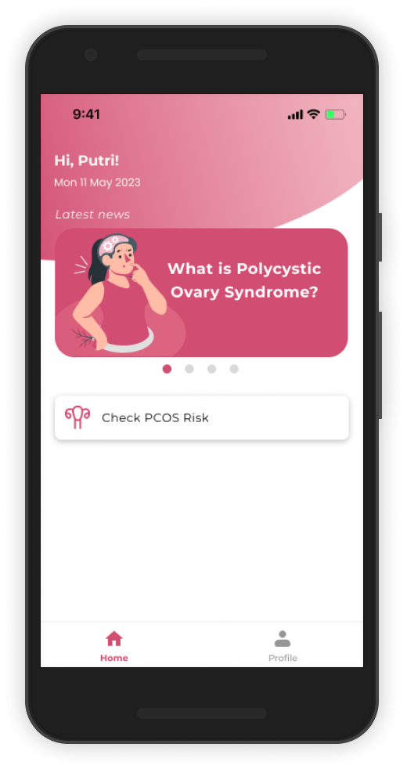
PCOS Pal
Introducing you to our apps !
PCOS Pal
PCOS Pal is a groundbreaking app designed exclusively for women. Empowering women with knowledge, PCOS Pal offering a prediction and assesses your potential risk of PCOS and provides personalized tips to safeguard your health.

Slide 5
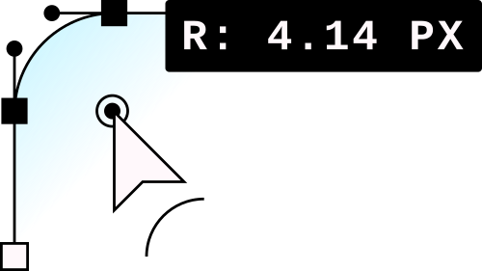
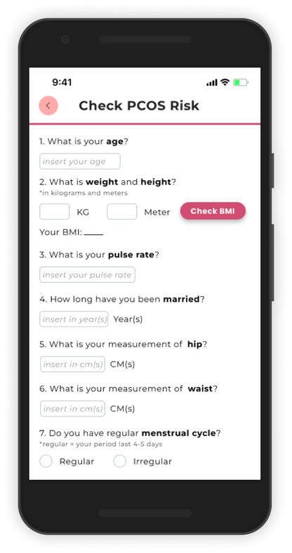
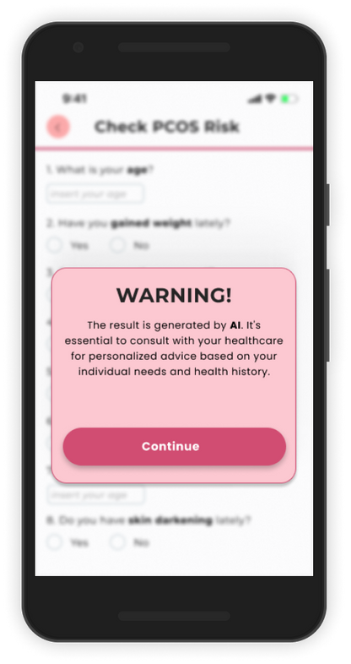
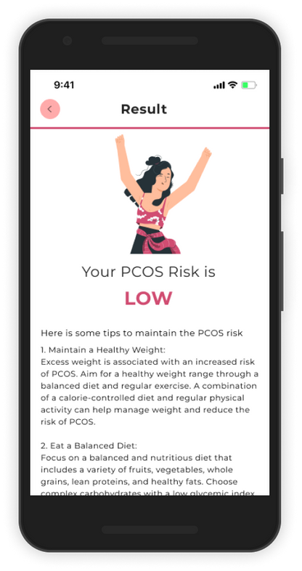
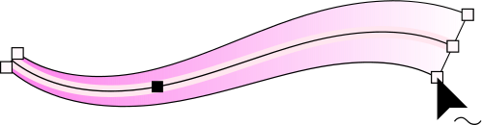
PCOS Pal
FEATURE
Check PCOS Risk
Fill questionnaire to assess your risk
Notes:
Our feature is CHECK PCOS RISK, end-user have to fill the questionnaire consinst of 12 question to assess her risk

Slide 6
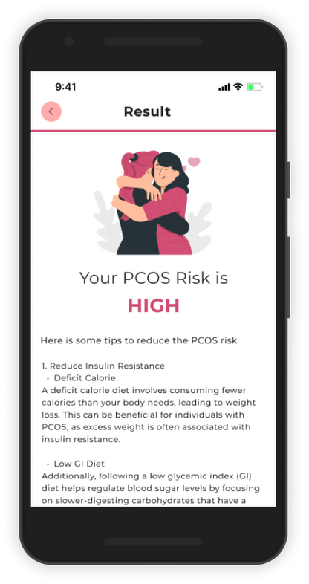
PCOS Pal
FEATURE
Improve Your Health
Get helpful tips based on your result
Notes:
after filling the qustion
end-user will get helpful tips generate by ChatGPT based on her result either The risk is LOW or The risk is high

Slide 7

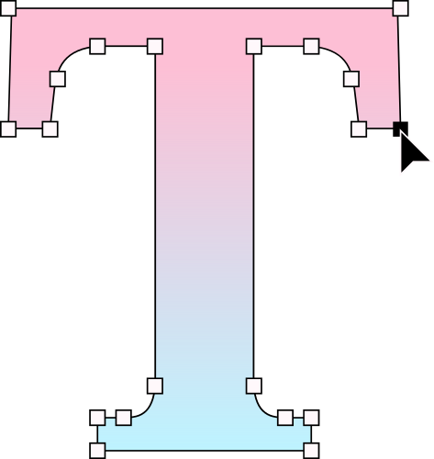

PCOS Pal
Current Target Market
WOMEN OF REPRODUCTIVE AGE
Women in the reproductive age are more susceptible due to significant hormonal changes that occur in their bodies which can disrupt the normal functioning of the reproductive system and lead them to PCOS. As a result, our apps aim to serve as a helpful tool for them to prevent and manage PCOS effectively.
PREGNANT MOTHER
Pregnant mothers are our target market because our objective is also to ensure the safety and well-being of both the mother and her unborn child. We want to provide them with the information and support to navigate the challenges and potential risks associated with pregnancy and PCOS.

Slide 8
PCOS Pal
Future Target Market
WIDER COMMUNITY
Online hub that brings together all women, healthcare professionals, and other stakeholders to create a supportive and educational network. It offers a range of features and resources to foster connections, provide information, and empower women to take an active role in their health journey.
HEALTH & MEDICAL CENTER
Health & Medical Center is the potential target market for PCOS Pal. By helping prospective patients get an early screening. We could reduce the number of fatalities caused by late diagnosis of PCOS, allowing health practitioners such as doctors to treat patients early.

Slide 9
PCOS Pal
WHY OUR TARGET MARKET NEED OUR SOLUTION?
Efficiency Priority
Our app aims to empower women by providing early detection and awareness of PCOS, allowing them to take proactive steps towards managing their health and seeking appropriate medical assistance.
Government reasoning
Governments and healthcare organizations have a vested interest in addressing PCOS due to its widespread impact on women's health and well-being.
Stakeholders related and benefited from our solution:
Women: The app empowers women by providing them with knowledge about their health, helping them identify potential PCOS symptoms, and encouraging them to seek timely medical advice.
Healthcare Professionals: The app provides healthcare professionals with an additional tool for early diagnosis and monitoring of PCOS.
Data-driven
Our app utilizes data-driven algorithms and machine learning techniques to analyze various factors such as medical history, symptoms, and lifestyle choices. By leveraging these data points, the app can accurately predict the likelihood of PCOS development in women.
Notes:
(END OF DATA-DRIVEN)
This data-driven approach ensures that the predictions are based on evidence and can provide valuable insights for healthcare professionals
(ENDS OF GOVERMENT REASONING)
By offering an app that can predict PCOS, we contribute to the government's efforts to improve women's reproductive health, reduce healthcare costs associated with undiagnosed or untreated PCOS, and promote early intervention and prevention strategies.
(ENDS OF 4TH)
Women : It allows them to take control of their reproductive health and make informed decisions.
Heathcare professional:
By leveraging the app's predictions, doctors can intervene earlier, provide appropriate treatment plans, and monitor the effectiveness of interventions over time.
There is 4 reasons, which is Effieciency priority, Data-driven, Government reasoning, and stakeholders related and benefited women and healthcare professional from our solution

Slide 10




PCOS Pal
Our Apps compared with the other !
Comparison | PCOS Pal | Similar App
Raising awareness about PCOS
Implementing AI on apps
Attractive UI
Provides risk prediction feature and health recommendations
Track analysis history for PCOS over time | Future Development
Discussion forum with the community | Future Development
Chat with personal healthcare provider | Future Development
Why
PCOS Pal ?

Slide 11
DEMO
PCOS Pal

Slide 12
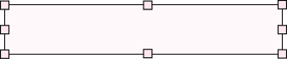
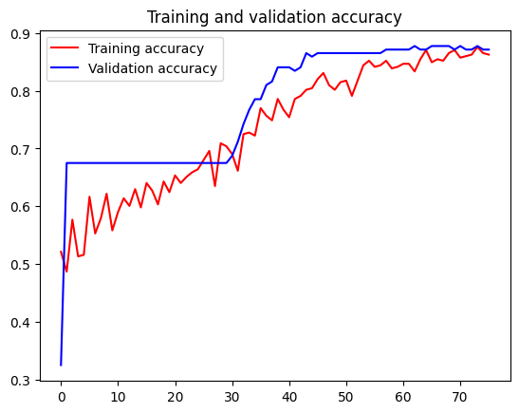
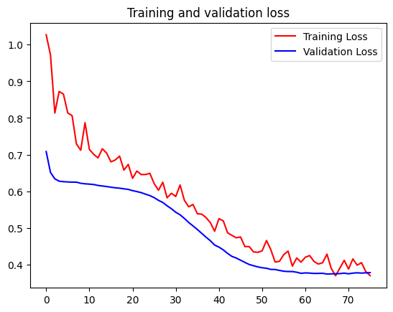
Result :
Machine Learning
PCOS Pal
Dataset
PCOS Diagnosis (from Kaggle) which contains 541 rows x 45 columns.
Link to reference: https://www.kaggle.com/code/karnikakapoor/pcos-diagnosis
Model Architecture
Evaluated on Train Data:
Accuracy : 0.8836
We implement the ANN algorithm for the ML model itself to perform a binary classification job that can classify two risk categories by training a neural network using the clean data provided. Additionally, we use Callbacks to prevent our model from taking training too long and preventing them from overfitting.
Loss : 0.3477
Evaluated on Val Data:
Accuracy : 0.8773
Loss : 0.3743
Model Layer
We applied several layers to our model, such as:
Keras Pre-Processing Layer
Dense Layer
Dropout Layer
More detail about our work:
https://github.com/ardhikaptr11/pcos-detection/blob/main/pcos-detection.ipynb

Slide 13






Result :
Cloud Computing
PCOS Pal
RESTful API
Node.js
Database
Express
Cloud SQL
Cloud Infrastructure & Cont. Deployment
Cloud Run
cloud build
artifact registry
Google Cloud

Slide 14

Result :
Cloud Computing
PCOS Pal
6
GET /
POST /api/login
GET /api/auth/user
POST /api/auth/pcos
Endpoints
POST /api/register
GET /api/auth/pcos/result
url: https://pcospal-3rd-test.et.r.appspot.com
Why Cloud Run?
Serverless Architecture
Scalability
Cost-Efficiency
Portability
Easy to deploy
Integration with Google Cloud Services
Multi-Region Deployment

Slide 15
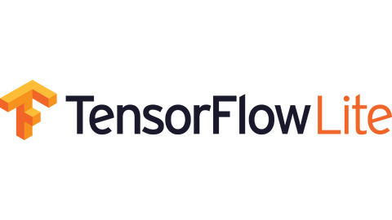

Result :
Mobile Development
PCOS Pal
Android Technologies
RecyclerView
A cross-platform machine
learning library optimised for running machine learning models on edge devices, including Android mobile devices
Display main feature
Networking to WEB API

Slide 16
PCOS Pal
Business Model Roadmap
Commercial Value and Business Opportunities
Generate revenue through freemium or subscription models, partnership, and sponsored content.
Market potential (PCOS affects millions of women worldwide)
Collaborate with pharmaceutical companies, or academic institution to develop targeted treatments and medications.
Technology Advantage and Science Breakthrough
The use of advanced algorithms (Machine learning and AI) enables the app to analyze large amounts of user data, identify patterns,improve prediction accuracy over time.
Collaborate with academic institutions and researchers to contribute to scientific breakthroughs in PCOS diagnosis, treatment, and prevention.
Long-Term Benefits and Indirect Effects:
Empower women to take control of their reproductive health leading to improved overall well-being, self-care, and quality of life.
Contribute to reducing healthcare costs associated with undiagnosed or mismanaged PCOS by promoting early intervention and preventive strategies
Generate a wealth of anonymized data that can be utilized for population health studies, policy development, and medical research, ultimately benefiting the healthcare industry and advancing scientific knowledge in women's health.
Tackling Bigger Problems in the Future:
Expand the app's capabilities beyond PCOS prediction, incorporating additional features for menstrual cycle tracking, fertility awareness, and hormonal health management.
Collaborate with experts in related fields to provide holistic support and guidance, for women's reproductive health.

Slide 17


Plan of Local Deployment
PCOS Pal
Fundraising
Alpha Testing
Develop new features
pitch to angel investors as additional funds from the results of Bangkit funding
ensure that our product is bug free and can perform as expected
added new key features to the app to reach more users
August
November
October
July
Desember
September
Partnership
Public launch
Add team members
Looking for expert mentor and collaborating with local community
Fix our bug (if any) and ready to release our product for public in Google play store
Hiring a marketing team and a member to the Mobile Development team

Slide 18
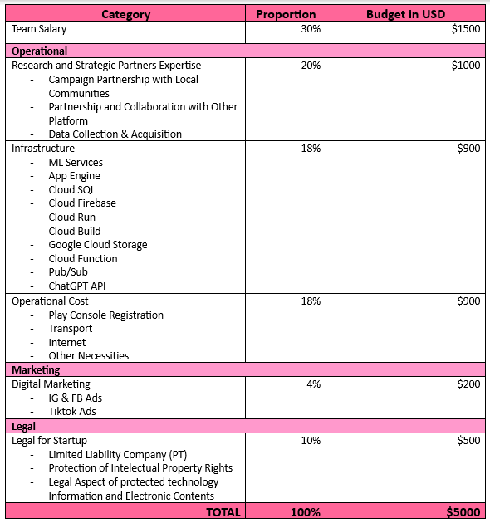


PCOS Pal
Budgeting 1
USD 5k
Expected runaway 6 months, with 7 People

Slide 19
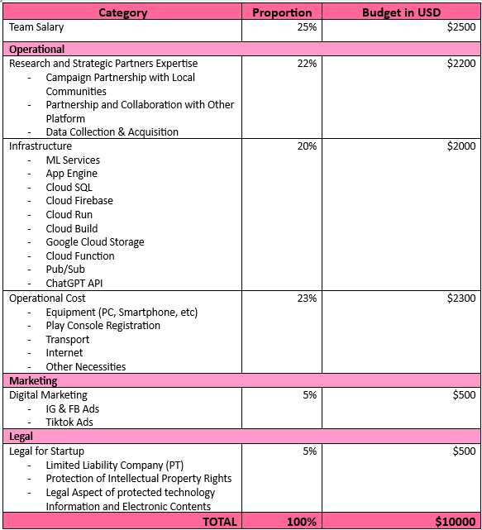

PCOS Pal
Budgeting 2
USD 10k
Expected runaway 1 Year, with 9 People

Slide 20
Sustainability
PCOS Pal
Source of Income
Freemium and subscription: 50 M
Users can make free predictions 2 times a month, the rest must be subscription users.
Freemium features offer direct consultation to expert doctors
Partnership with healthcare organization: 50 M
Being a partner of another health platform as a subfeature,
Become a partner of government and healthcare organization
App Advertising: 20 M
Rounds of Funding: 140 M
Efficiency Priority
Enhancing the efficiency of data processing and analysis
Efficiency app's interface design and interface
Cloud-based services and utilizing serverless architectures

Slide 21


C23-PS058
Thank You
YOUR ULTIMATE COMPANION IN PREVENTING PCOS!

Slide 22
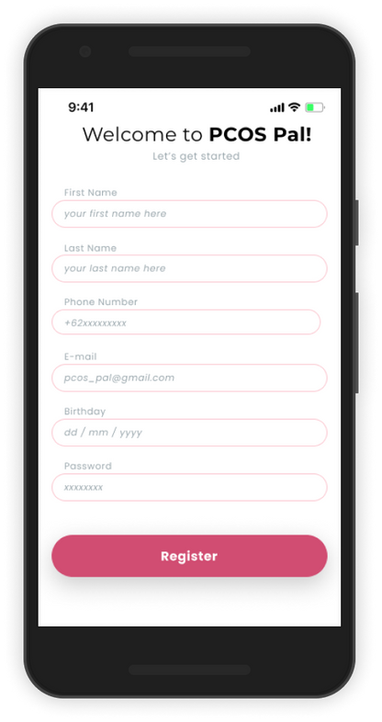
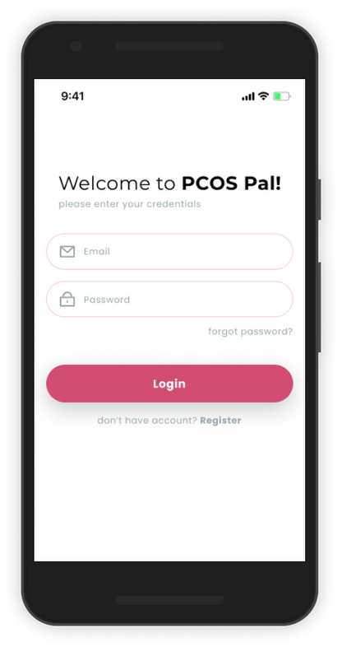

PCOS Pal
Mockups

Slide 23
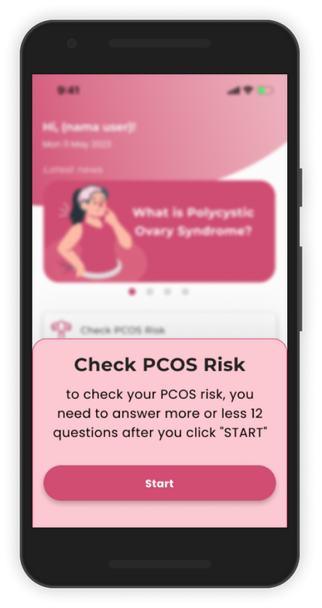
PCOS Pal
Mockups (2)

Slide 24
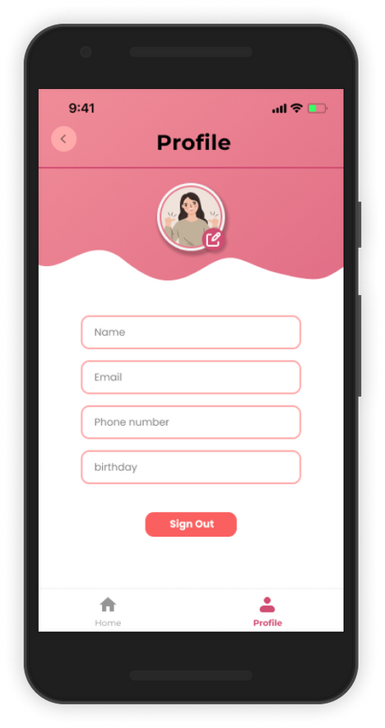
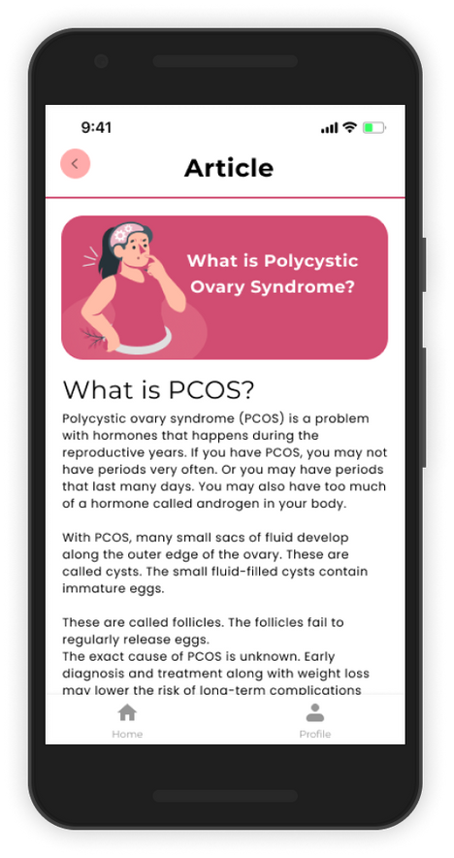
PCOS Pal
Mockups (3)

